Slide 1


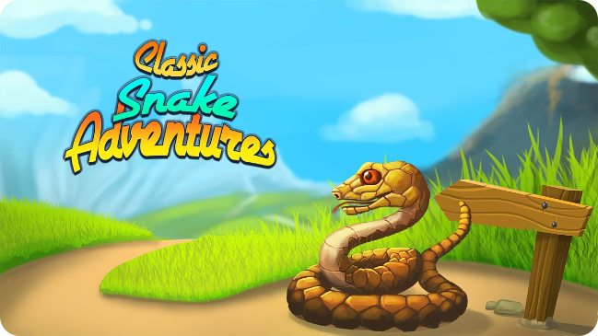
Deep Reinforcement Learning: Building a Snake Game Agent
Deep reinforcement learning (DRL) is a powerful technique that combines deep learning with reinforcement learning. This project will create a DRL agent for the classic Snake game. We will use Python and a deep neural network to teach the snake to navigate the environment and maximize its score.

Slide 2
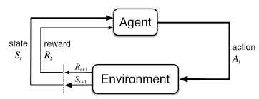
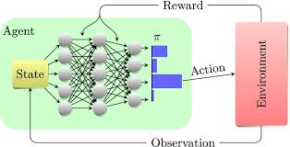
Deep Reinforcement Learning
Agent - The learner or decision-maker
Environment - Everything the agent interacts with
Actions - What the agent can do
State - Different situations the agent can be in
Reward - Feedback from the environment

Slide 3
Introduction to the Snake Game
The Snake game is a simple yet engaging game. The player controls a snake that moves around a grid, eating food to grow longer. The goal is to reach the highest score possible without colliding with the walls or itself. This game provides a perfect environment for training a DRL agent to learn how to navigate obstacles and make decisions.
1
Game State
The game state includes the snake's position, direction, and the location of food. It's represented as a grid of pixel.
2
Actions
The snake can choose from a limited set of actions, such as moving up, down, left, or right. The action taken at each time step determines the snake's movement and the game state.
3
Reward
The snake receives a positive reward for eating food and a negative reward for colliding with walls or itself. This reward system guides the agent to learn the optimal behavior.

Slide 4

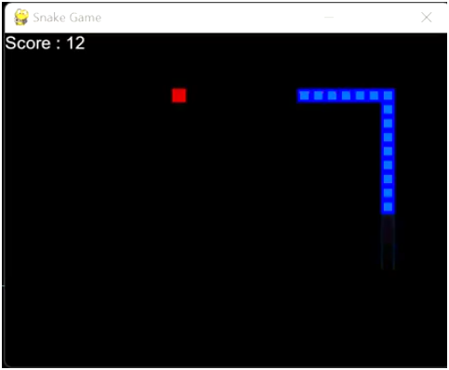
Designing the Snake Game Environment
The snake game environment is designed to be simple and straightforward, allowing the DRL agent to focus on learning the core gameplay mechanics. It consists of a grid-based world, a snake, food, and boundaries. The environment provides a clear observation of the game state and provides rewards for actions taken.
Grid
Snake
The game board is a 2D grid (32x32) where the snake navigates, eats food, and avoids collisions. The size of the grid can be adjusted for difficulty.
The snake is the controlled agent. Its length increases with each food consumed. It moves through the grid according to the actions taken by the agent.
Food
Boundaries
Designed in pygame by Patrick Loeber
Food is randomly generated within the grid. The snake receives a reward for consuming the food and increases its length. A new food item is generated after each consumption.
The environment has boundaries that the snake cannot cross. Colliding with the boundaries results in a negative reward and terminates the game.

Slide 5
Methodology
Image Processing
Feature Extraction
Game Env (RGB Image)
Grayscale
Resize (64x64)
Binarization (0 or 1)
CNN Layers
Learns by Adjusting Weights
Game Env (Returns Rewards)
Agent Takes Action
Output Actions (Q-Values)
FC Layers
Deep Q-Learning

Slide 6
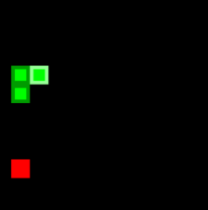
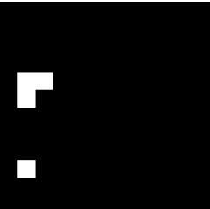
Image Processing (RGB to Binarization)
The DRL agent needs to learn from the game's visual information. The game environment is first captured as a sequence of RGB images. This RGB information is then converted into a binary format for processing, making it easier for the CNN to analyze and learn from the game state.
RGB Image
Binarization
The raw image captured from the game environment. It contains information about the colors of different elements like the snake, food, and background.
The RGB image is converted into a binary image. Each pixel is represented as either black or white. This simplifies the image for processing, making it easier for the DRL agent to extract relevant information.

Slide 7

Reward Mechanism for Snake Game
The reward mechanism is crucial for guiding the DRL agent's learning process. It defines the desired behavior and provides incentives for the agent to learn. The reward system for the Snake game encourages the agent to maximize its score by eating food and avoiding collisions.
Moves | Rewards | Results
Eats an Apple | +10 | Score Increases
Hits with a wall or itself | -10 | End of episode
Not eats neither dies | -1 | Continue playing
1
Positive Reward
2
Negative Reward
When the snake consumes food, it receives a positive reward. This incentivizes the agent to seek out food and increase its length.
When the snake collides with itself or the boundaries, it receives a negative reward. This discourages the agent from making self-destructive actions.
3
Terminal State
The game ends either when the snake collides with itself or the boundaries, or if it reaches a specific score limit. These are considered terminal states.

Slide 8

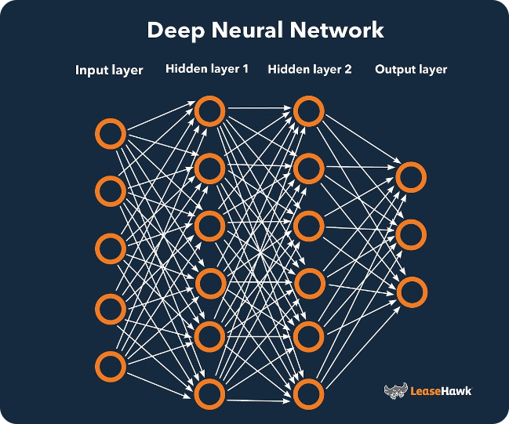
Implementing the Deep Neural Network for Q-Learning
The DRL agent uses a deep neural network to learn the optimal policy for playing the Snake game. The network takes the game state (binarized image of 64x64 pixels) as input and outputs the Q-values, which represent the expected rewards for each possible action. The network is trained using the Q-learning algorithm, which aims to find the optimal policy by maximizing the expected cumulative rewards over time.
Input
Binarized Image
Multiple layers with activation functions (Conv2d, ReLU, MaxPool2d, FC)
Hidden Layers
Output
Q-values for each action

Slide 9
The Code

Slide 10


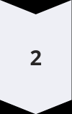
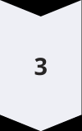

Training the Deep Reinforcement Learning Model
The DRL model is trained through a process of exploration and exploitation. The agent explores the environment by taking random actions, learning from the rewards it receives. This exploration helps the agent discover new states and actions. Exploitation involves using the learned knowledge to maximize rewards. This process continues until the agent converges to a near-optimal policy.
Initialization
The model is initialized with random weights and biases.
Exploration
The agent takes random actions to explore the environment.
Learning
The agent updates its weights and biases based on the rewards received.
Exploitation
The agent uses its learned knowledge to maximize rewards.

Slide 11

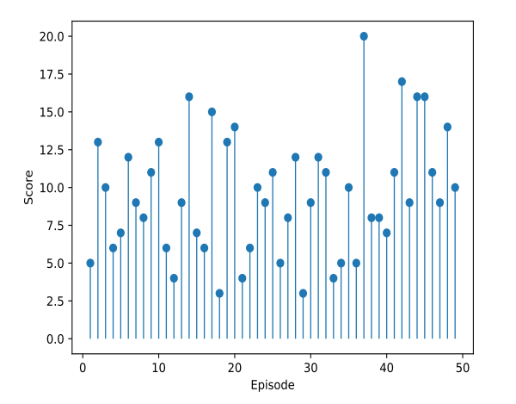



Evaluating the Model's Performance
Once the DRL model is trained, its performance is evaluated to measure its effectiveness. Various metrics are used to assess the agent's ability to navigate the game, eat food, and achieve high scores. These metrics help to understand the agent's learning progress and identify areas for improvement.
Score v/s Episode
The average score achieved by the agent over a number of games. A higher average score indicates better performance.
Maximum Length
The maximum length the snake reaches during a game. This measures the agent's ability to avoid collisions and consume food.
Survival Rate
The percentage of games where the agent survives for a certain duration. A higher survival rate indicates a more stable policy.

Slide 12

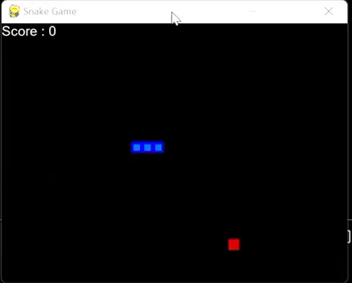
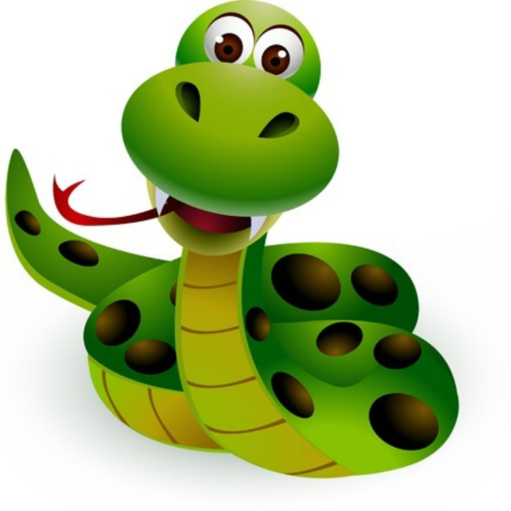

Slide 13

Optimizing the Snake Game Agent
The DRL model can be further optimized to enhance its performance. This involves fine-tuning the model architecture, hyperparameters, and training process. By experimenting with different combinations, we can improve the agent's ability to learn and achieve higher scores.
1
Network Architecture
2
Hyperparameters
3
Environment Functions
Experimenting with different numbers of hidden layers and neurons can improve the network's ability to extract relevant features.
Tuning hyperparameters like learning rate, discount factor, and exploration rate can affect the learning speed and convergence.
Reward function based on actions, length and steps taken can improve the performance.

Slide 14
Conclusion and Future Directions
This project successfully demonstrates the use of DRL for training an intelligent agent to play the Snake game. The agent learned to navigate the environment, eat food, and avoid collisions, achieving a high level of performance. There are various exciting future directions for this project.
1
Advanced Techniques
2
Complex Environments
Exploring more advanced DRL techniques like deep Q-networks (DQN) and asynchronous advantage actor-critic (A3C) for enhanced performance.
Training the agent in more complex environments with obstacles, dynamic elements, and multiple enemies.
3
Real-World Applications
Applying DRL concepts to real-world problems like robotics, autonomous driving, and resource optimization.

Slide 15
References
M. R. R. Tushar and S. Siddique, "A Memory Efficient Deep Reinforcement Learning Approach For Snake Game Autonomous Agents," 2022 IEEE 16th International Conference on Application of Information and Communication Technologies (AICT), Washington DC, DC, USA, 2022, pp. 1-6, doi: 10.1109/AICT55583.2022.10013603. keywords: {Performance evaluation;Deep learning;Training;Image coding;Memory management;Games;Reinforcement learning;Deep Reinforcement Learning;Convolutional Neural Network;Deep Q Learning;Hyperparameter Tuning;Replay Size;Image Preprocessing},

Slide 16
Thank You
Shyam Bahadur Verma
Manohar Gehlot
Sahil Shah
Raj Kumar
Harsh Patel

